Slide 1

Anomaly detection: A survey
Varun chandola, arindam banerjee and vipin kumar
Acm computing surveys, vol. 41, n°3, article 15, publication date: july 2009

Slide 2
Introduction
Anomaly detection refers to the problem of finding patterns in data that do not conform to expected behavior (anomalies, outliers, exception, peculiarities, ecc.).

Slide 3
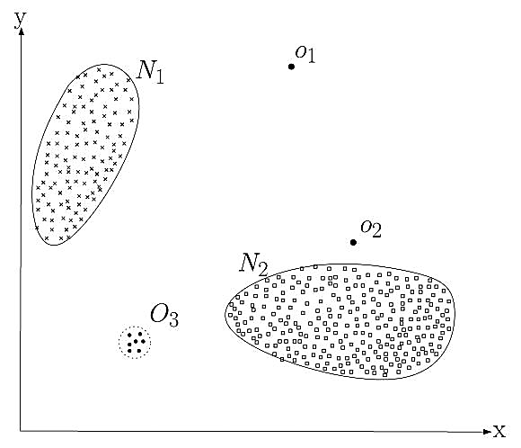
Introduction
Anomaly detection refers to the problem of finding patterns in data that do not conform to expected behavior (anomalies, outliers, exception, peculiarities, ecc.).

Slide 4
Introduction
Anomaly detection refers to the problem of finding patterns in data that do not conform to expected behavior (anomalies, outliers, exception, peculiarities, ecc.).
Wide variety of applications (fraud detection, intrusion detection, fault detection)

Slide 5
Anomaly detection
What is anomaly detection?
Anomalies are patterns in data that do not conform to a well defined notion of normal behavior
Anomalies are interesting to the analyst
Anomaly detection aims finding these patterns

Slide 6
Anomaly detection
What is anomaly detection?
Anomalies are patterns in data that do not conform to a well defined notion of normal behavior
Anomalies are interesting to the analyst
Anomaly detection aims finding these patterns
What is not anomaly detection?
Anomaly detection is distinct from noise removal or noise accomodation
Noise can be defined as a phenomenon in data that is not of interest to the analyst but act as a hindrance to data analysis.

Slide 7
challenges
Define a region representing a normal behavior and declare any observation in the data that does not belong to this normal region as an anomaly:
Defining a region that encompasses every possible normal behavior is very difficult
Boundary between normal and anomalous behavior is often not precise
Malicious adversaries make the anomalous observations appear normal
Normal behavior can keeps evolving
Exact notion of anomaly is different for different application domains
Data contains noise

Slide 8
Nature of input data
Each data instance can be described using a set of attributes
Attributes can be of different types
Univariate/multivariate (in the second case attributes might be a mixture of types)

Slide 9
Nature of input data
Each data instance can be described using a set of attributes
Attributes can be of different types
Univariate/multivariate (in the second case attributes might be a mixture of types)
Sequence data:
Instances are linearly ordered (time-series, genome, ecc.)

Slide 10
Nature of input data
Each data instance can be described using a set of attributes
Attributes can be of different types
Univariate/multivariate (in the second case attributes might be a mixture of types)
Sequence data:
Instances are linearly ordered (time-series, genome, ecc.)
Spatial data:
Instances are related to their neighboring instances (vehicular traffic data, ecological, ecc.)

Slide 11
Nature of input data
Each data instance can be described using a set of attributes
Attributes can be of different types
Univariate/multivariate (in the second case attributes might be a mixture of types)
Sequence data:
Instances are linearly ordered (time-series, genome, ecc.)
Spatial data:
Instances are related to their neighboring instances (vehicular traffic data, ecological, ecc.)
Graph data:
Instances are represented as vertices in a graph connected with other vertices with edges

Slide 12
Type of anomaly
Point anomalies
An individual data instance considered as anomalous with respect to the rest of data

Slide 13
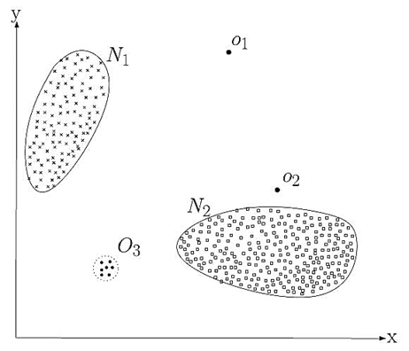
Type of anomaly

Slide 14
Type of anomaly
Point anomalies
An individual data instance considered as anomalous with respect to the rest of data
Contextual anomalies
A data instance can be anomalous in a specific context but not otherwise

Slide 15
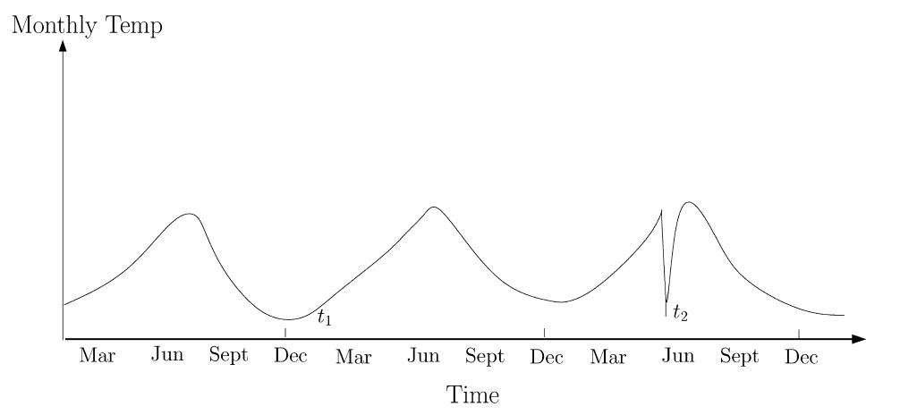
Type of anomaly

Slide 16
Type of anomaly
Point anomalies
An individual data instance considered as anomalous with respect to the rest of data
Contextual anomalies
A data instance can be anomalous in a specific context but not otherwise
Collective anomalies
A collection of related data instances considered as anomalous with respect to the entire data set

Slide 17
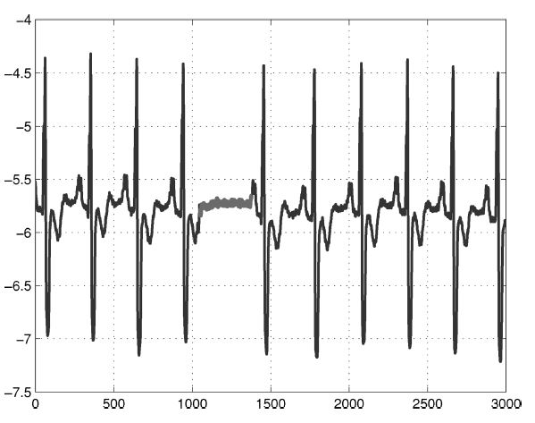
Type of anomaly

Slide 18
Training data set
Some techniques need a training data set
The labels associated with a data instance denote wheter that instance is normal or anomalous
Labelling is often done manually by a human expert
Getting a labeled training set of anomalous data instances that covers all possible type of anomalous behavior is more difficult than getting it for normal behaviors

Slide 19
Training data set
Some techniques need a training data set
The labels associated with a data instance denote wheter that instance is normal or anomalous
Labelling is often done manually by a human expert
Getting a labeled set of anomalous data instances that covers all possible type of anomalous behavior is more difficult than getting it for normal behaviors
Supervised anomaly detection techniques
Availability of a training data set that has labeled instances for normal and anomaly classes

Slide 20
Training data set
Some techniques need a training data set
The labels associated with a data instance denote wheter that instance is normal or anomalous
Labelling is often done manually by a human expert
Getting a labeled set of anomalous data instances that covers all possible type of anomalous behavior is more difficult than getting it for normal behaviors
Supervised anomaly detection techniques
Availability of a training data set that has labeled instances for normal and anomaly classes
Semisupervised anomaly detection techniques
Training data has labeled instances only for the normal class

Slide 21
Training data set
Some techniques need a training data set
The labels associated with a data instance denote wheter that instance is normal or anomalous
Labelling is often done manually by a human expert
Getting a labeled set of anomalous data instances that covers all possible type of anomalous behavior is more difficult than getting it for normal behaviors
Supervised anomaly detection techniques
Availability of a training data set that has labeled instances for normal and anomaly classes
Semisupervised anomaly detection techniques
Training data has labeled instances only for the normal class
Unsupervised anomaly detection techniques
Do not require training data

Slide 22
Output of anomaly detection
Labels
Techniques in this category assign a label to each test instance (normal or anomalous)
Binary labels

Slide 23
Output of anomaly detection
Labels
Techniques in this category assign a label to each test instance (normal or anomalous)
Binary labels
Scores
Scoring techniques assign an anomaly score to each instance in the test data depending on the degree to wich that instance is considered anomaly
Ranked list

Slide 24
Classification based techniques
Classification is used to learn a model (classifier) from a set of labeled data instances (training) and then, classify a test instance into one of the classes using the model (testing)

Slide 25
Classification based techniques
Classification is used to learn a model (classifier) from a set of labeled data instances (training) and then, classify a test instance into one of the classes using the model (testing)
Training phase
(learn a classifier using training data)
Testing phase
(classifies a test instance as normal or anomalous using classifier)

Slide 26
Classification based techniques
Classification is used to learn a model (classifier) from a set of labeled data instances (training) and then, classify a test instance into one of the classes using the model (testing)
Multi-class or one-class anomaly detection techniques
Training phase
(learn a classifier using training data)
Testing phase
(classifies a test instance as normal or anomalous using classifier)

Slide 27
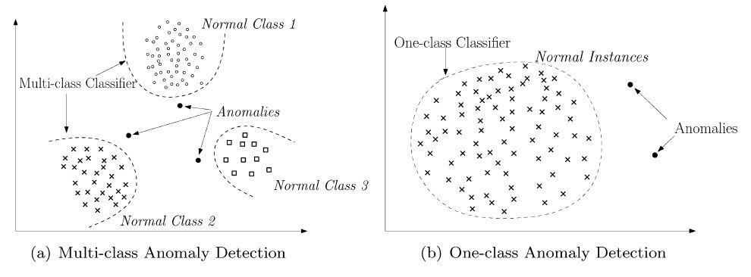
Classification based techniques

Slide 28
Classification based techniques
Classification is used to learn a model (classifier) from a set of labeled data instances (training) and then, classify a test instance into one of the classes using the model (testing)
Multi-class or one-class anomaly detection techniques
Neural network
Rule based
Training phase
(learn a classifier using training data)
Testing phase
(classifies a test instance as normal or anomalous using classifier)

Slide 29
Neural network based techniques
Multi-class as well as one-class settings
A neural network is trained on the normal training data to learn the different normal classes.
Each test instance is provided as an input to the neural network
If the network accepts the test input, it is normal, otherwise, it is an anomaly
Several variant of basic neural network have been proposed

Slide 30
Rule-based techniques
Rule-based anomaly detection techniques learn rules that capture the normal behavior of a system
Multi-class as well as one-class settings
Each rule has an associated confidence value that is proportional to ratio between the number of training instances correctly classified by the rule and the total number of training instances covered by the rule.
The inverse of the confidence associated with the best rule is the anomaly score of the test instance

Slide 31
Rule-based techniques
Learn rules from the trainig data using a learning algorithm (RIPPER, decision trees,…)

Slide 32
Rule-based techniques
Learn rules from the trainig data using a learning algorithm (RIPPER, decision trees,…)
Find, for each test instance, the rule that best captures the test instance

Slide 33
Computational complexity
The computational complexity of classification based techniques depends on the classification algorithm being used
Generally, training decision trees tend to be faster, while techniques that involve quadratic optimization, such support-vector machines based, are more expensive
Testing phase is usually very fast since the testing phase uses a lerned model for classification

Slide 34
Advantages and disadvantages
Advantages
Classification-based techniques, especially the multi-class techniques, can make use of powerful algorithms
The testing phase is fast, since each test instance needs to be compared against the precomputed model

Slide 35
Advantages and disadvantages
Advantages
Classification-based techniques, especially the multi-class techniques, can make use of powerful algorithms
The testing phase is fast, since each test instance needs to be compared against the precomputed model
Disadvantages
Multi-class classification based techniques rely on the availability of accurate labels fo various normal classes, wich is often not possible
Classification-based techniques assign a binary label to each test instance (become a disadvantage when a meaningful anomaly score is desired)

Slide 36
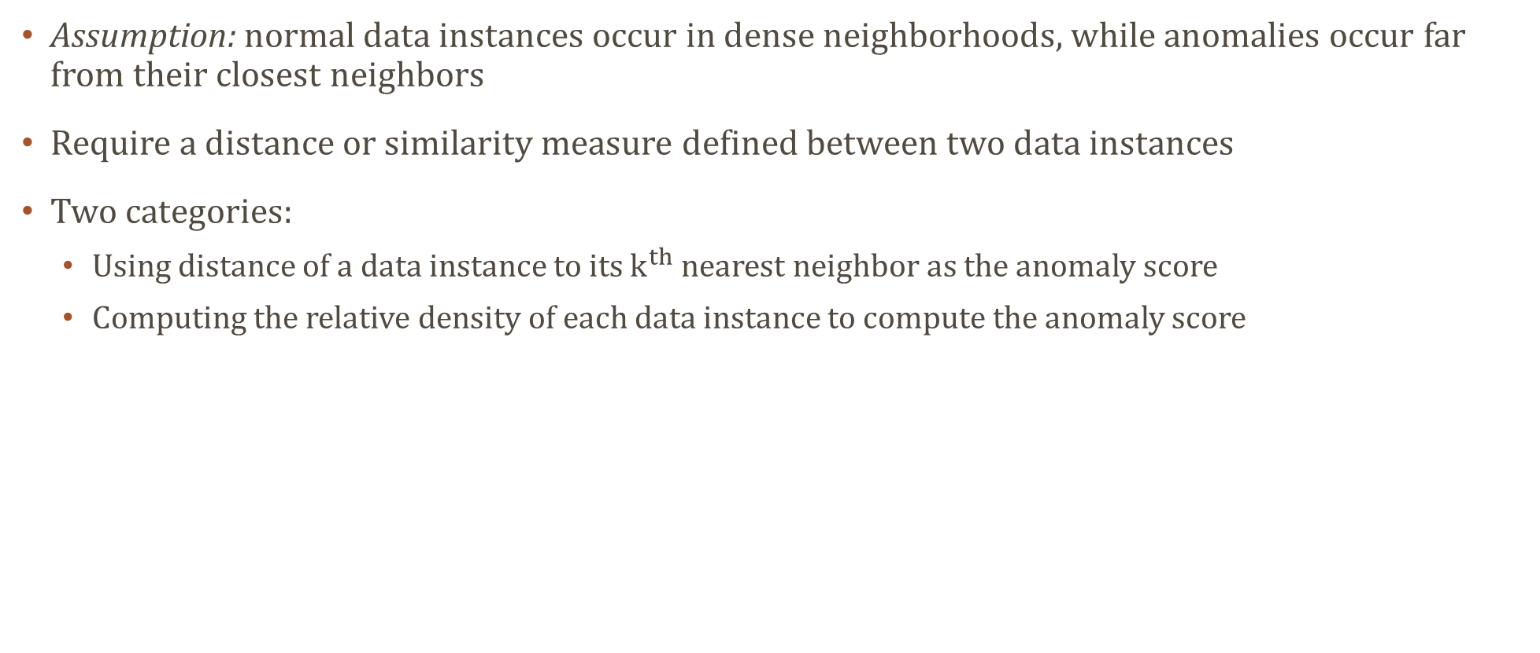
Nearest neighbour-based techniques
Assumption: normal data instances occur in dense neighborhoods, while anomalies occur far from their closest neighbors
Require a distance or similarity measure defined between two data instances
Two categories:
Using distance of a data instance to its $k^{th}$ nearest neighbor as the anomaly score
Computing the relative density of each data instance to compute the anomaly score

Slide 37

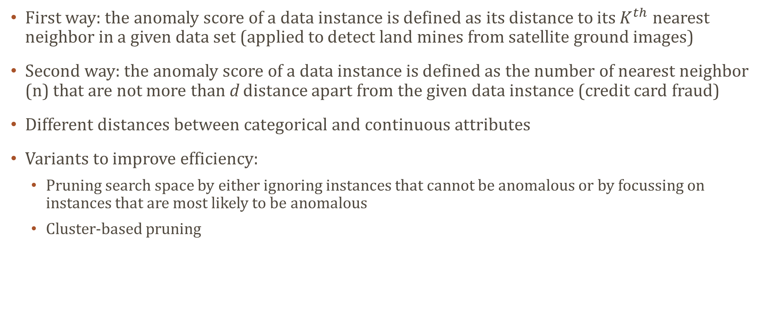
$K^{th}$nearest neighbor
First way: the anomaly score of a data instance is defined as its distance to its $K^{th}$ nearest neighbor in a given data set (applied to detect land mines from satellite ground images)
Second way: the anomaly score of a data instance is defined as the number of nearest neighbor (n) that are not more than d distance apart from the given data instance (credit card fraud)
Different distances between categorical and continuous attributes
Variants to improve efficiency:
Pruning search space by either ignoring instances that cannot be anomalous or by focussing on instances that are most likely to be anomalous
Cluster-based pruning

Slide 38
Relative density
An instance that lies in a neighborhood with low density is declared to be anomalous while an instance that lies in a dense neighborhood is declared to be normal
These techniques perform poorly if the data has regions of varying densities

Slide 39
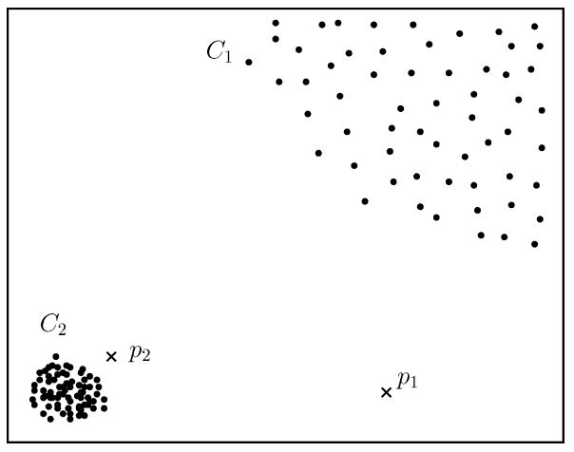
Relative density

Slide 40
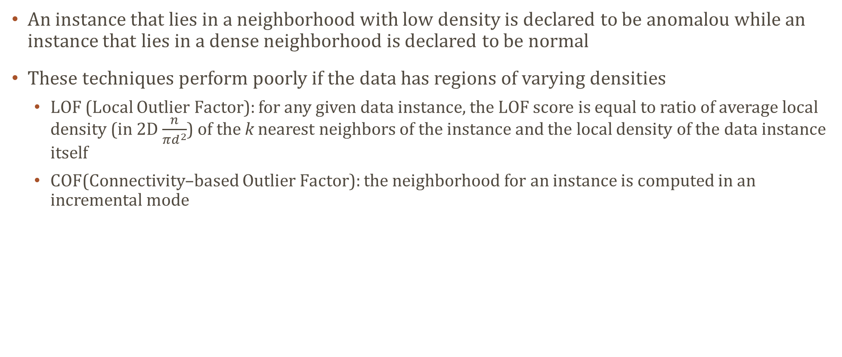
Relative density
An instance that lies in a neighborhood with low density is declared to be anomalou while an instance that lies in a dense neighborhood is declared to be normal
These techniques perform poorly if the data has regions of varying densities
LOF (Local Outlier Factor): for any given data instance, the LOF score is equal to ratio of average local density (in 2D $\frac{n}{πd^{2}}$) of the k nearest neighbors of the instance and the local density of the data instance itself
COF(Connectivity–based Outlier Factor): the neighborhood for an instance is computed in an incremental mode

Slide 41
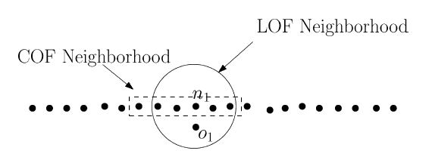
Relative density

Slide 42

Computational complexity
Basic techniques has $O\left(N^{2}\right)$ complexity
More efficient data structure can be used
Several techniques has directly optimized the anomaly detection under the assumption that only the top few anomalies are insteresting

Slide 43
Advantages and disadvantages
Advantages
Unsupervised (purely data driven)
Semisupervised techniques perform better than unsupervised in term of missed anomalies
To adapt nearest neighbor-based techniques to a different type is straightforward (only need distance)
Disadvantages
For unsupervised techniques we can have missed anomalies (normal instances without enough close neighbors or anomalies with enough close neighbors)
Computational complexity
Defining distance measures between instances can be challenging

Slide 44
Clustering-based anomaly detection
Unsupervised techniques

Slide 45
Clustering-based anomaly detection
Unsupervised techniques
Two categories:
Normal data instances belong to a cluster in the data, while anomalies do not belong to any cluster
Apply a known clustering-based algorithm to the data set and declare any data instance that does not belong to any cluster as anomalous
Normal data instance lie close to their closest cluster centroid, while anomalies are far away from their closest cluster centroid
The data is clustered using a clustering algorithm, then, for each data instance, its distance to its closest cluster centroid is calculated as its anomaly score

Slide 46
Clustering-based anomaly detection
Unsupervised techniques
Two categories:
Normal data instances belong to a cluster in the data, while anomalies do not belong to any cluster
Apply a known clustering-based algorithm to the data set and declare any data instance that does not belong to any cluster as anomalous
Normal data instance lie close to their closest cluster centroid, while anomalies are far away from their closest cluster centroid
The data is clustered using a clustering algorithm, then, for each data instance, its distance to its closest cluster centroid is calculated as its anomaly score
If the anomalies in the data form clusters by themselves, these techniques will not be able to detect such anomalies.
Normal data instances belong to large and dense clusters, while anomalies belong to small or sparse cluster

Slide 47
Computational complexity
Depends on the clustering algorithm used to generate clusters from the data
Clustering algorithms have generally quadratic complexity
Heuristic-based techniques have linear complexity
Testing phase is really fast since it envolves comparing a test instance with a small number of clusters

Slide 48
Advantages and disadvantages
Advantages
Unsupervised (purely data driven)
To adapt clustering techniques to a different type is straightforward (clustering algorithm)
Testing phase is very fast
Disadvantages
Performance depends on the effectiveness of clustering algorithm
Many techniques detect anomalies as a byproduct of clustering, and hence are not optimized for anomaly detection
Several clustering algorithms force every instance to be assigned to some cluster
Several clustering based techniques are effective only when the anomalies do not form significant clusters among themselves
Computational complexity for clustering the data

Slide 49
Other techniques
Statistical anomaly detection techniques
Parametric techniques
Non parametric techniques
Information theoretic anomaly detection techniques
Spectral anomaly detection techniques
……

Slide 50
applications
Intrusion detection
Detection of malicious activity (break-ins, penetrations, and other form of computer abuse)
Huge volume of data
Data tipically comes in streaming fashion, thereby requiring online analysis
False alarm rate due to large sized input
Semisupervised and unsupervised techniques are preferred
Host-based intrusion detection systems
Network-based intrusion detection system

Slide 51
applications
Host-based intrusion detection systems
Anomalous subsequences in operating system call traces (collective anomalies)

Slide 52
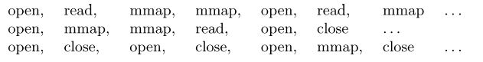
applications

Slide 53
applications
Host-based intrusion detection systems
Anomalous subsequences in operating system call traces (collective anomalies)
Co-occurence of events is the key factor in differentiating between normal or anomalous
Alphabet is usually large (183 system calls for SunOS 4.1x OS)
The length of the sequence for each program varies
Sequencial data
Point anomaly detection techniques are not applicable in this domain

Slide 54
applications
Host-based intrusion detection systems
Anomalous subsequences in operating system call traces (collective anomalies)
Co-occurence of events is the key factor in differentiating between normal or anomalous
Alphabet is usually large (183 system calls for SunOS 4.1x OS)
The length of the sequence for each program varies
Sequencial data
Point anomaly detection techniques are not applicable in this domain
Network-based intrusion detection systems
Detecting intrusion in network data (point anomalies)
Data available can be at different levels of granularity (packet level, CISCO net-flows data)
The nature of anomalies keeps changing over time

Slide 55
applications
Medical and public health anomaly detection
Patient records (age, blood group, weight,…)
Abnormal patient condition, instrumentation errors, recording errors…
Is a very critical problem in this domain and requires a high degree of accuracy
Data might have a temporal as well as spatial aspect too
Detecting anomalous records (point anomalies)
Semisupervised approach
Cost of classifying an anomaly as normal can be very high

Slide 56
applications
Image processing (satellite imagery, mammographic image analysis, video surveillance..)
Motion or insertion of a foreign object
Data has spatial and temporal aspects
Continuous attribute(color, lightness, texture…)
Key challenge in this domain is the large size of the input

Slide 57
applications
Fraud detection
Detection of criminal activities occurring in commercial organizations (banks, insurance ecc.)
Users consume the resources provided by the organization in an unauthorized way
Needs an immediate detection
Maintain usage profile for each customer and detect any deviations
Credit card, mobile phone, insurance claim, insider trading fraud detection

Slide 58
applications
Fraud detection
Detection of criminal activities occurring in commercial organizations (banks, insurance ecc.)
Users consume the resources provided by the organization in an unauthorized way
Needs an immediate detection
Maintain usage profile for each customer and detect any deviations
Credit card, mobile phone, insurance claim, insider trading fraud detection
Credit card fraud detection
Data is typically comprised of records defined over several dimensions
The frauds are typically reflected in transactional records (point anomalies)
Profiling and clustering based techniques are typically used in this domain
Contextual anomalies

Slide 59
applications
Industrial damage detection
Detect damage (continuous usage and normal wear and tear) early to prevent further escalation
Data referred to sensor data
Temporal aspect and time-series analysis
Mostly contextual (anomalies occur in a specific context) or collective anomalies (anomalous sequence of observations)
Online detection as preventive measures are required to be taken as soon as an anomaly occurs
Typically normal data pertaining to components is readily availabele and hence semisupervised techniques are applicable

Slide 60
applications
Sensor networks
Speech recognition
Traffic monitoring
Anomalous biological data
Associations among criminal activities
Anomalies in astronomical data
Ecosystem disturbance
Text data
…………

Slide 61
conclusions
Anomalies in data translate to significant and often critical information in a wide variety of application domains
Unlimited applications
Very challenging problem
Each problem is different from any other

Slide 62
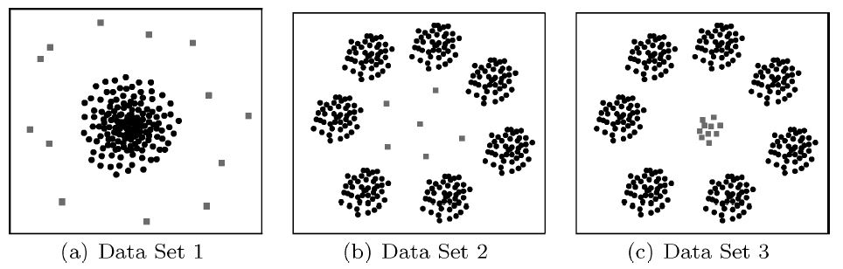
conclusions

Slide 63



The end
Questions?
Varun chandola
University at Buffalo
Arindam banerjee
University of Minnesota
Vipin kumar
University of Minnesota

Slide 64
The end
Thank you!
Varun chandola
University at Buffalo
Arindam banerjee
University of Minnesota
Vipin kumar
University of Minnesota

